Slide 1

HR Metrics and Workforce Analytics
No Balance NO ROI – The Rise of BIG Data
Notes:
Johnson Controls 170k employees recently used Big Data to reduce their time to fill from 54 to 37 days.

Slide 2





I’m a MultiTasker
Donna
Full-Time
Volunteer
Part-Time
College Relations Director
& Past State Council Dir
Department of Management Faculty
Former MAC Rep
for NCRC
SHRM
HR Consultant

Slide 3
Program Description
Regardless of the size of the organization, HR metrics and workforce analytics are becoming increasingly beneficial. With the transition of HR metrics and analytics over the past 30 years, managers are now finding it easier to balance the costs and benefits of decisions due to improved HR infrastructures.
However, HR metrics and workforce analytics are not a guarantee return on investment. You need to be able to decipher what data is appropriate to collect. Learn how to use this information to increase managerial decision-making efficiency.
This program will help you align workforce and HR metrics with HR objectives, business strategies, and organizational goals. It will also teach you how to implement HR metrics and workforce analytics to improve organizational results.
Technology
MATCHING
IMPLEMENT

Slide 4
Learning Objectives
How to develop and implement HR metrics and workforce analytics to measure organizational results vs. its goals and objectives (SPHR Functional Area 01-06).
When and how to align and incorporate metrics into business plans to achieve growth and improve revenue (SPHR Functional Area 01-12).
How to use metrics to conduct cost/benefit analyses and increase managerial decision-making capacity (SPHR Functional Area 01-12).
How to select the important and appropriate data to collect and analyze.

Slide 5


Title Slide Visual as it relates to ROI
Reconnaissance …is the military term for exploring beyond the area occupied by friendly forces to gain vital information about enemy forces or features of the environment for later analysis and/or dissemination.
Prior Military
@HRWarrior
Notes:
This entails figuring our where you are what you need to do, what you can do and what will wait. There will be friendly and unfriendly forces and there may be combat too! This exercise will largely involve reading people and seeing who is with you and who is against you. You must clearly understand this.

Slide 6
Let’s Jump Right In?

Slide 7


Begin with the end in mind?
Notes:
John Sumser on a recent Drive Thru HR spoke about the future of HR and how it will eventually be a numbers driving field like all other business fields already are required. He envisions some HR professionals eventually loosing their jobs because they can’t get the numbers right. The future of HR will be technology based. In many ways it already is especially if you compare it to the 1990’s when the first HR technology was introduced called Applicant Tracking. Personally, the company I worked for at the time was on top of this as one of my projects was to research and implement a training tracking software. We settled with a program called Registrar.
Registrar was software used in the personnel or human resources (HR) area of businesses. It was the first piece of software developed^{[citation needed]} to provide HR with the ability to manage training administration, booking people on courses, sending call-up letters, and recording their attendance. It enabled HR users to build their own data dictionaries without any help from their IT people. The Registrar software was created by Silton-Bookman Systems (SBS). It was launched in the USA in 1984 and became one of the leading training administration software programs on the market with over 5000 installations.^{[1]} It was eventually incorporated into an LMS when SBS merged with Pathlore in 2000. Therefore Registrar itself is no longer available for sale. Pathlore was subsequently acquired by SumTotal Systems in 2005.

Slide 8
What is: ROI (aka Return on Investment)
Demonstrates efficiency with which resources are used.
“Hurdle rate” is minimum ROI organization requires from project investments.
Presents data as a percentage.
ROI =

Slide 9
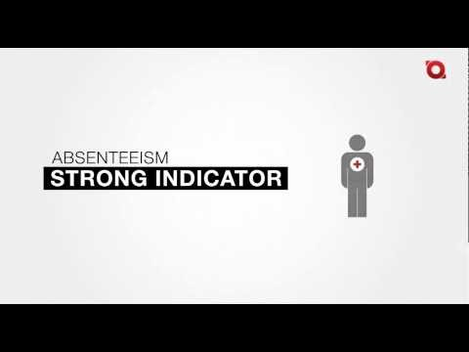
ROI on Absenteeism as Example

Slide 10
ROI in Human Capital
Does your Human Capital ROI come in at
Researchers for the report found that from 2002 to 2006, the return on investment for human capital rose by 8.3 percent in Western Europe and 4.6 percent in the United Kingdom. During the same period, the return on investment increased 19.8 percent in the United States.
- See more at: http://www.shrm.org/india/hr-topics-and-strategy/strategic-hrm/talent-acquisition-strategy-metrics-and-communication/pages/study_%20u.s.%20tops%20europe%20in%20return%20on%20human%20capital%20investments.aspx#sthash.sfNd2FMM.dpuf

Slide 11


Is this real?
Balanced measures…

Slide 12

You say Ugh!
When I say metrics, Do you…

Slide 13

Not Numbers!”
Have you said? “I joined hr because I like working with people…

Slide 14


Measure or…Consider This!
To admit to clients and senior managers that the impact of human resources cannot be measured is to admit
that HR programs do not add value
or that the HR department should not be held accountable for its impact--positive or negative--on the organization's bottom line.

Slide 15
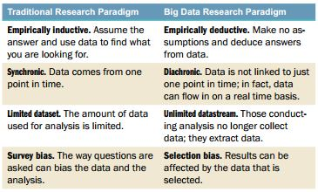
What big data is and what it isn’t
Magnitude of size Analyze data in real time
Patel, 2013
http://www.shrm.org/about/foundation/products/pages/2013tlretreat.aspx

Slide 16

Why Should You Invest in HR Metrics
Benefits seen regardless of company size
Not a guarantee return on investment.
  Must determine what data is appropriate to collect.
  Learn how to use this information to increase managerial decision-making efficiency.
Remember the Hawthorne Theory?
The Hawthorne effect (also referred to as the observer effect) refers to a phenomenon whereby workers improve or modify an aspect of their behavior in response to the fact of change in their environment, rather than in response to the nature of the change itself. The "Hawthorne effect" study suggested that the novelty of having research conducted and the increased attention from such could lead to temporary increases in productivity.

Slide 17
Making Big Data Small,
Manageable, & Actionable
Focus on a small number of specific HR measures that are clearly linked to business strategy.
  Don’t attempt to track all HR benchmark measures listed as “best practices”.
  Identify the goal of collecting data.
  Determine who will collect the data and how often.
  Locate relevant and trusted sources of data.
  Make basic calculations.
  Compare results to external and internal benchmarks.

Slide 18

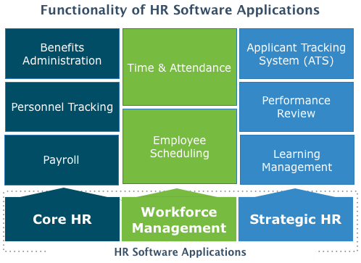




Why is this a #HR HOT TOPIC?
Implementation of integrated HRIS has increased the capacity accessing and examining data
Real time analysis & distribution of information - Growing interest in evidence based mgmt.
http://www.softwareadvice.com/hr/

Slide 19



#HRTech is Here & Now
#HRTechConf

Slide 20
So..What are HR Metrics?
Way to quantify the cost and the impact of employee programs
  Can quantify the cost of HR processes and measure the success of HR initiatives.
  Measures time of the money spent
  Allows you to track yearly trends
EXAMPLE: Cost Per Hire
(CPH) = the sum of external costs (recruiting) and internal costs (training new employees) divided by the total number of starts in a time period.

Slide 21
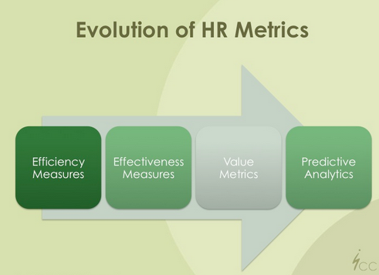
Modern HR Metrics and Analytics
Transition period
  More organizations are now reporting a larger number of metrics more consistently
  Most organizations use metrics to audit their HR activities

Slide 22
Emphasis on Improving Managerial Decision Making
HR metrics and analytics can only impact the organization
if and only if:
  Managers are given adequate information
  Managers make better decisions
  Managers make different decisions

Slide 23
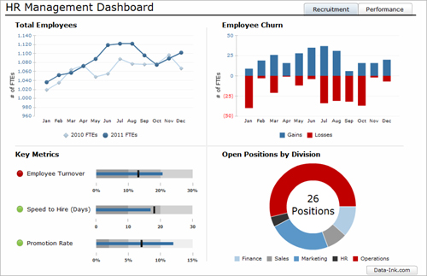
Common Activities Used in HR Metrics and Analytics
  Reporting
  Dashboards
  Benchmarking
  Data Mining
  Predictive Analyses
  Operational Experiments
  Workforce Modeling

Slide 24
Balanced Scorecard
Aligns business function measures with organizational strategies.
Measures the effectiveness of a department or the entire company.
Considers perspective of all stakeholders.
Mission
Vision
Values
Finance
Customers
Learning and growth
Internal business processes

Slide 25
Primary and Secondary Research
Primary (data gathered firsthand) | Secondary (data gathered by others)
Experiments Pilot projects Surveys/questionnaires Interviews Focus groups Direct observation Testing | Historical data Benchmarking and best-practices reports Purchased data Professional publications Secondhand reports

Slide 26
Quantitative v. Qualitative Research
Quantitative
Qualitative
Collects and analyzes numerical data in a descriptive or inferential manner.
Uses: Describe groups, compare results, identify trends or commonalities.
Examples: Charts and graphs, statistical measures, regression analysis.
Collects attitudes, opinions, and feelings.
Uses: Identify strengths and weaknesses, generate ideas, determine preferences.
Examples: Focus groups, in-depth interviews, questionnaires.

Slide 27
Qualitative Analysis: Interviews
Cautions
Interviewer’s nonverbal actions can influence responses.
Interviewers should be careful not to ask leading questions.
Interviewees may answer with what they think is “right.”
Benefits
Yield insightful information.
Provide opinions and reactions to events.
Allow for personal connection to interviewee.
Are flexible.

Slide 28
Qualitative Analysis:
Surveys and Questionnaires
Cautions
Less flexible than interviews.
Can produce low response rate, which yields little data and impairs analysis.
Benefits
Ensure interviewee anonymity.
Are efficient; can gather data from many respondents.
Standardize data collection.

Slide 29
Reliability
Ability of an instrument to measure consistently.
Parallel form method compares results of similar tests administered to same group at two times.
Here Test A shows less variability and is therefore considered more reliable.
Candidate | Test A |  | Test B
 | First test | Retest | First test | Retest
1 | 90 | 92 | 87 | 95
2 | 89 | 90 | 79 | 86
3 | 92 | 94 | 81 | 93

Slide 30
Validity
Ability of an instrument to measure what it is intended to measure.
Answers the questions:
  What does the instrument measure?
  How well does the instrument measure it?
A reliable instrument is not always valid.
A valid instrument is always reliable.

Slide 31
Choosing Proper Metrics to Measure
Must have the 3 A’s.
*Metrics should include a people component and directly influence the business.
Accessible
Auditable
Actionable

Slide 32
5 tips for developing and managing HR metrics
Key to success

Slide 33

Know and show why an HR metric matters
Why are you keeping track of the metric?
Why is it important?
If a metric’s connection to a business priority is not apparent, don’t track it.
HR to Staff Ratio = Employees / HR Team Members. This ratio is important since during the recession HR departments have reduced in number dramatically. HR serves as the internal customer support staff just like call center customer service employees serve as external facing.
Read more at http://www.blogging4jobs.com/hr/best-hr-metrics-human-resources-examples/#msEPpZOOUTdsZMoq.99

Slide 34

KISS: Keep it Simple (Stupid)
The metric will no be used if the information is not clear or it is complicated to gather and calculate
Sophisticated calculations are time consuming, so keep it simple!
Employee Absence Rate = number of days in month / (average number of employees during month x number of days). I have used this analysis to look at employee absence rates for different departments and managers. Sometimes the best way to determine if their is a culture or manager opportunity is through evaluating the percentage of absences by department or manager.
Read more at http://www.blogging4jobs.com/hr/best-hr-metrics-human-resources-examples/#msEPpZOOUTdsZMoq.99

Slide 35

Keep your Managers in Mind
High level managers may not be interested in the same metrics as HR
Create some metrics that tracks HR efficiency and gather other reports for executives.
Average Employee Age = Total Age of Employees / Headcount. This is an important metric in my mind when looking at succession planning and forecasting staffing areas of opportunity as older workers begin to consider retirement. Also an important metric when calculating benefits cost for your organization.
Read more at http://www.blogging4jobs.com/hr/best-hr-metrics-human-resources-examples/#msEPpZOOUTdsZMoq.99

Slide 36


Connect HR Metrics to Business Metrics
HR metrics should always be connected to strategic objectives!
  Start with understanding the organizational strategy
  Create a strategy map
  Ready to create HR metrics

Slide 37

Don’t know what they are?
Ask:
“What are the business Metrics”
Notes:
Not metrics for the LDP. It may be to early… but what does the business measure themselves against to show success?

Slide 38
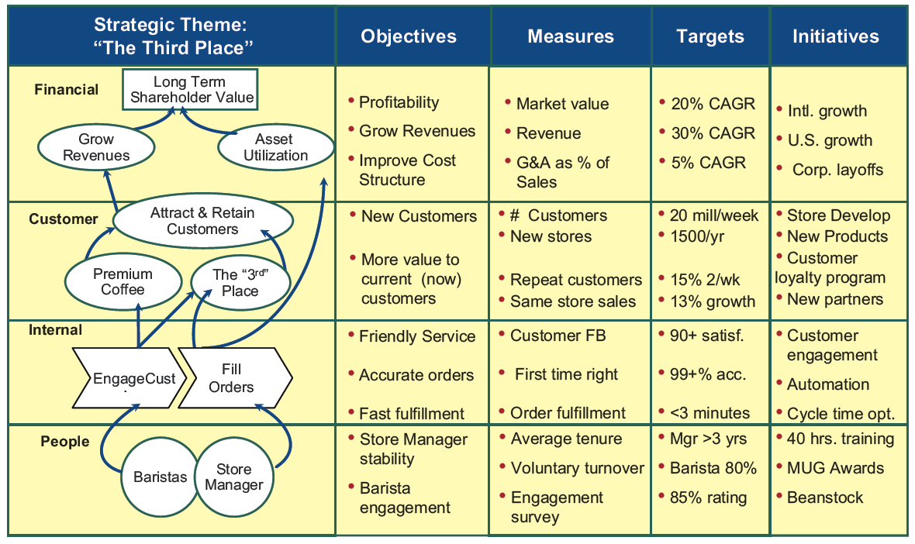
FIGURE
2.11
Building the Metrics Model

Slide 39


Metrics
Metric/Tool | Examples
Surveys | Smile Sheets, 30 Day Behavior Change, Annual Corporate Employee Satisfaction Survey
Comparisons | Performance Mgmt System Competency/Behavior Change Performance of Direct Reports | Promotion Rates 360 Assessments LDP vs. Everyone else
Mentoring Relationship | Mentoring Surveys + involvement across the business View from Mentee / Mentor
Business Metrics | Individual and Group contribution to Business Goals Business Case Results Performance and Annual Reviews Delivery on Change Management Increase Coaching and Business Contribution
Notes:
Major Point
Remember that METRICS are not the same as RESULTS
Metrics collect data points, RESULTS show proof of action (what is actual vs what is collected)

Slide 40


Promote, communicate and share metrics widely
Be sure to promote metrics that demonstrate a positive impact of people on the bottom line
Should be presented in the proper context to show the strategic impact of what is being measured.
Promotion Rate = Promotions / Headcount.

Slide 41
3 Basic HR Metrics
#1 Staff Absentee Rate
Formula: # of days in month / (# of employees x # of days)
#2 Monthly Turnover Rate
Formula: # of separations in month / # of employees
#3 Recruiting Source Yield
Formula: # of applicants hired / # of applicants from recruiting source

Slide 42
Other Measurement Methods
Organization’s most important issues (e.g., dollar sales per employee)
Human capital ROI
Turnover cost
Compensation as a percentage of operating expense
Training investment factor
Time to start
Cost per hire

Slide 43
Metric “Don’ts”
Always be willing to learn!
Bigger is not better
Don’t neglect the organizational strategy –THIS IS THE MOST COMMON MISTAKE
  The organizational strategy is key to determining what measure matters most.
  Essential in determining which people metrics will measure human capital impact.
Remember to include information that interests top executives and not just HR
Not every HR function that can be measured should be.

Slide 44
Know Where Your Org Is

Slide 45

COMPETITIVE
Comparisons

Slide 46



Official Standards
Published Standards
ANSI/SHRM 09001.2012, Performance Management
Designed as a proposed set of minimum elements of a performance management system in three areas - goal setting, performance review and performance improvement plans.
ANSI/SHRM 06001.2012, Cost-per-Hire
Designed as a tool to allow an organization to determine accurate and comparable costs of recruitment through a standard algorithm to calculate the recruiting costs to be incorporated into cost-per-hire. Standard is structured at a high level. Specific consideration and responses are also addressed for consideration by individual organizations based on specific hiring environments and requirements. Errata: On page 16 of the standard, in Table 4, the first column should be labeled "Internal Costs", not "External Costs"
ASIS/SHRM WPVI.1-2011, Workplace Violence Prevention and Intervention Standard (In conjunction with ASIS)
Provides an overview of general security policies, processes, and protocols that organizations can adopt to help prevent threatening behavior and violence affecting the workplace and better respond to and resolve security incidents involving threats and episodes of actual violence.
- See more at: http://www.shrm.org/hrstandards/publishedstandards/pages/default.aspx#sthash.uRgtwOmX.dpuf

Slide 48
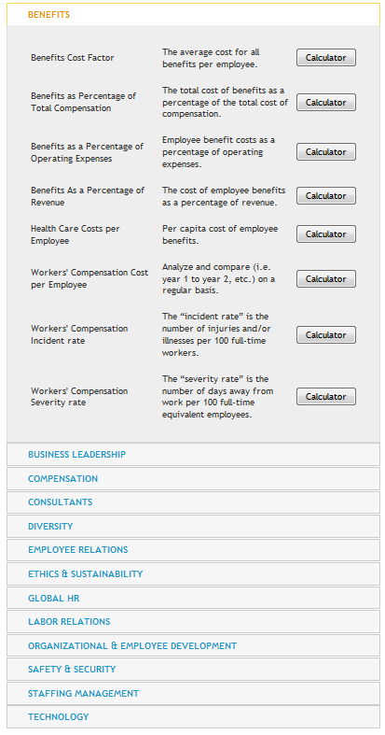
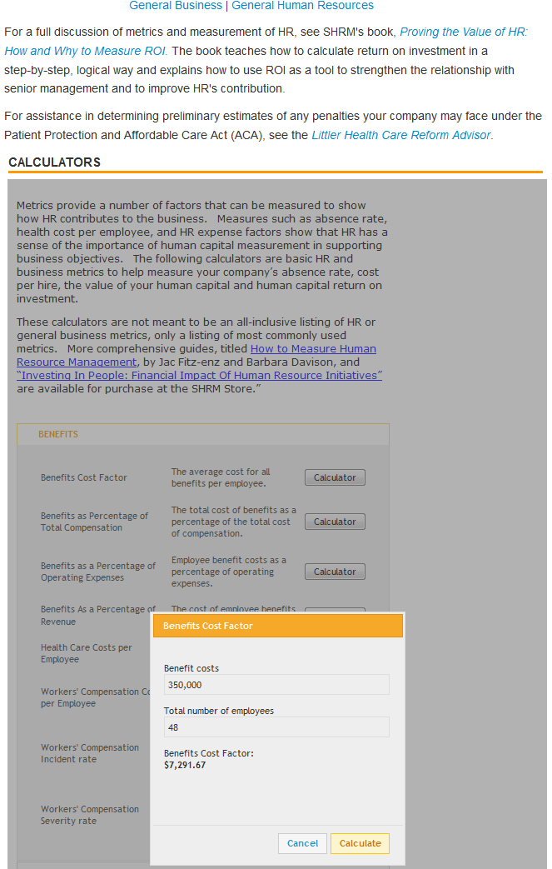
FREE Calculators

Slide 49
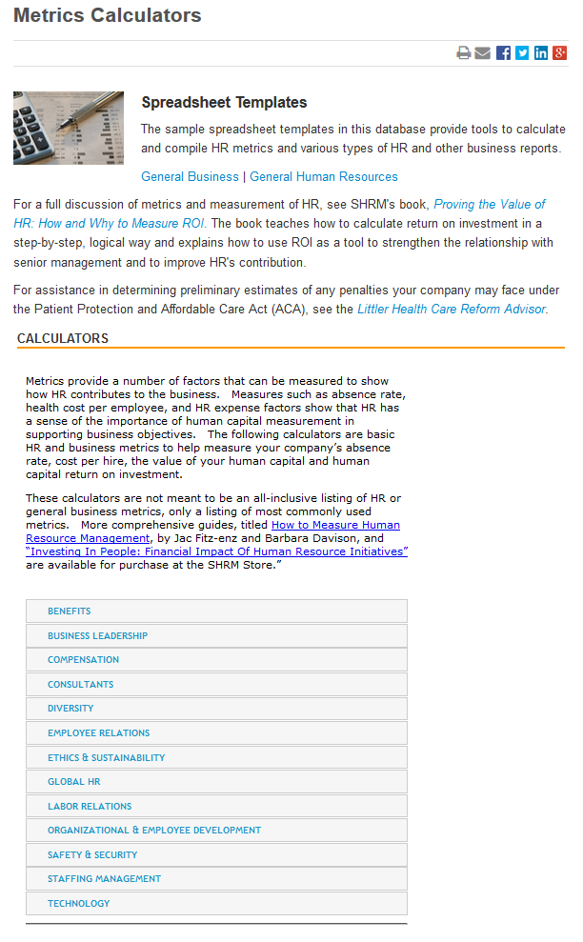
Calculators
COMING SOON:
Ethics & Sustainability
Global HR
Safety & Security
Technology
8
18
17
1
8
8
1
18
37
Benefits
Business Leadership
Compensation
Consultants
Diversity
Employee Relations
Labor Relations
Organizational & Employee Development
Staffing Management
116
http://www.shrm.org/templatestools/samples/metrics/pages/default.aspx

Slide 50
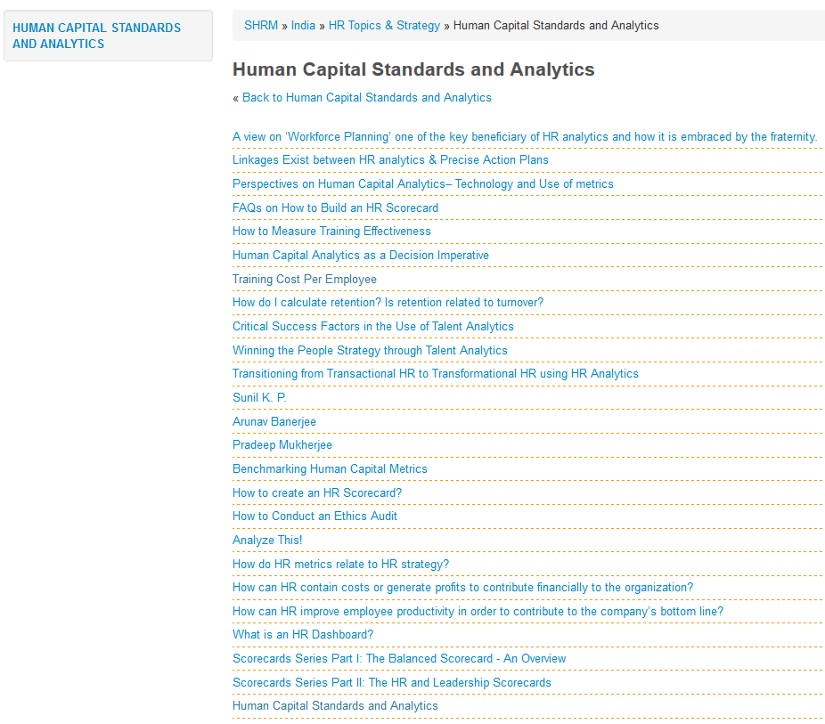
Human Capital Standards & Analytics Resources

Slide 51
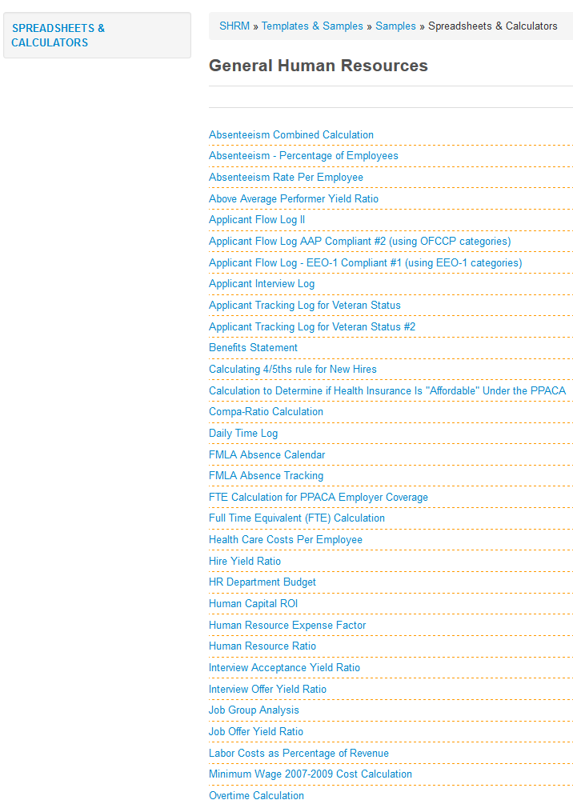
Spreadsheet Templates

Slide 52
Excel Spreadsheets
Absenteeism, Average Rate per Employee
(Formulas are included.)
 | No. of |  | No. of |  | Average Absence
 | Absences |  | Employees |  | Rate Per
 |  |  |  |  | Employee
January | 4 |  | 88 |  | 4.55%
February | 1 |  | 88 |  | 1.14%
March | 4 |  | 88 |  | 4.55%
April | 6 |  | 83 |  | 7.23%
May | 2 |  | 84 |  | 2.38%
June | 1 |  | 85 |  | 1.18%
July | 4 |  | 87 |  | 4.60%
August | 6 |  | 88 |  | 6.82%
September | 3 |  | 88 |  | 3.41%
October | 7 |  | 88 |  | 7.95%
November | 3 |  | 86 |  | 3.49%
December | 2 |  | 85 |  | 2.35%
TOTALS | 43 |  | 3.583333333 |  | 4.14%
Note: The formula for average absence rate per employee is the number of absences divided by the total number of employees on payroll during the period.
Turnover Calculation
(Formulas are included)
 | Number of Employees | Average Number | Turnover Rate
 | Separated During | Employees During | (Monthly)
 | Month | Month
January | 1 | 100 | 0.01
February | 4 | 98 | 0.040816327
March | 3 | 98 | 0.030612245
1st Quarter | 8 |  | 0.081428571
April | 0 | 94 | 0
May | 2 | 95 | 0.021052632
June | 4 | 96 | 0.041666667
2nd Quarter | 6 |  | 0.062719298
July | 1 | 98 | 0.010204082
August | 2 | 98 | 0.020408163
September | 3 | 97 | 0.030927835
3rd Quarter | 6 |  | 0.06154008
October | 2 | 98 | 0.020408163
November | 1 | 99 | 0.01010101
December | 3 | 100 | 0.03
4th Quarter | 6 |  | 0.060509173
Annual |  |  | 0.266197123
Note: Formula for monthly turnover rate is the number of employees separated during the month divided by the average number of employees in the month multiplied by 100

Slide 53

Case Study
What is the value of computing Turnover?

Slide 54


Employee Turnover Rates
Computing Turnover Rates:
  The U.S. Department of Labor suggests the following formula for computing turnover rates:
  Thus, if there were 25 separations during a month and the total number of employees at mid month was 500, the turnover rate would be:

Slide 55


Employee Turnover Rates (cont’d)
Computing Turnover Rates (cont’d):
  Another method of computing the turnover rate is one that reflects only the avoidable separations (S). This rate is computed by subtracting unavoidable separations (US) from all separations. The formula for this method is as follows:
  where M represents the total number of employees at mid month. For example, if there were 25 separations during a month, 5 of which were US, and the total number of employees at mid month (M) was 500, the turnover rate would be:

Slide 56
Costs Associated with the Turnover of One Computer Programmer
(Turnover costs = Separation costs + Replacement costs + Training costs)
Separation costs
Exit interview cost for salary and benefits of both interviewer and departing employee during the exit interview = $30+$30 = $60
Administrative and record-keeping action = $30
Total separation costs = $60 + $30 = $90
Replacement costs
Advertising for job opening = $2,500
Preemployment administrative functions and record-keeping action = $100
Selection interview = $250
Employment tests = $40
Meetings to discuss candidates (salary and benefits of managers while participating in meetings)= $250
Total replacement costs = $2,500 + $100 + $250 + $40 + $250 = $3,140
Training costs
Booklets, manuals, and reports = $50
Education = $240/day for new employee’s salary and benefits x 10 days of workshops, seminars, or courses = $2,400
One-to-one coaching = ($240/day/new employee + $240/day/staff coach or job expert) x 20 days of one-to-one coaching = $9,600
Salary and benefits of new employee until he or she gets “up to par” = $240/day for salary and benefits x 20 days = $4,800
Training costs = $50 + $2,400 + $9,600 + $4,800 = $16,850
Total turnover costs= $90 + $3,140 + $16,850 = $20,080

Slide 57

Books
TABLE OF CONTENTS
Preface: ROI as an HR Tool
Acknowledgments
Preface to the Second Edition
Chapter 1. The Accountability Crisis
Chapter 2. The ROI Methodology
Chapter 3. Preparing for ROI
Chapter 4. Data Collection Issues
Chapter 5. Isolating the Effects of the Program
Chapter 6. Converting Data to Money
Chapter 7. HR Costs and ROI
Chapter 8. Measuring Intangibles
Chapter 9. Communicating and Using Evaluation Data
Chapter 10. Taking a Sensible Approach to ROI
Chapter 11. Case Study: Measuring ROI for a Work-at-Home Program
Epilogue
Appendix A. Self-Test: How Results-Based Are Your Human Resources Programs?
Appendix B. ROI Case Studies
Appendix C. Resources
This book has been approved for HRCI recertification credit. For details, see the SHRM Store's FAQ here. - See more at: http://www.shrm.org/publications/books/pages/provingthevalueofhr2d.aspx#sthash.YrwGDm6v.dpuf

Slide 58

Another Book
enables you to upgrade your standing in the company by showing the effectiveness of your department through solid, factual, and verifiable data;
justify your toughest managerial decisions - ranging from how many additional staff people to hire to how much to spend on your training program - with specific numbers obtained from easy-to-use mathematical formulas;
quantify your department's contribution to the overall bottom line;
set firm, achievable goals and priorities;
collect numerical data on costs, time, and the quantity and quality of work and
accurately measure virtually anything you want to measure - from a specific task to the way your entire department is organized.

Slide 59

The HR Scorecards
'The Human Resources Scorecard: measuring the return on investment' is the first book to provide a comprehensive, step-by-step process for measuring return on investment in human resources programs. Based on the classic ROI definition of earnings divided by investment, the ROI Process developed 20 years ago by co-author Jack J Phillips aids managers in determining and improving the bottom-line impact that human resource programs have on an organization. The ROI Process provides six additional measures in the form of a scorecard to track and monitor the total impact of the human resource programs.
'The Human Resources Scorecard' is essential for human resource executives, professionals, CEOs, CFOs, consultants, professors and other managers concerned with their businesses' bottom lines.
Jack J. Phillips, Ph.D. is a renowned expert of measurement and evaluation. He provides consulting services for Fortune 500 companies and workshops for major conference providers throughout the world. He is also an author or editor of more than 20 books and 100 articles.
Ron D. Stone is vice president and chief consulting officer for Performance Resources Organization. He is also director of the company's consulting practices in measurement and accountability. He has published numerous articles on the subject of ROI.
Patricia Pulliam Phillips is chairman and CEO of the Chelsea Group, a consulting and publishing organization that focuses on accountability issues in organizations. She works with organizations to implement measurement and evaluation processes.

Slide 60

What Questions Do you Have?
droge1@uis.edu
217-414-1297
Donna Rogers, Med., SPHR

Slide 61
Thank You!
Donna Rogers, M.Ed., SPHR
Instructor, Management Department
College of Business and Management
University of Illinois at Springfield
University Hall, UHB 4073
One University Plaza, MS UHB 4060
Springfield, Illinois 62703-5407
217.206.8264o
217.414.1297c or Donna@RogersHR.com
217.206.7543f
droge1@uis.edu

